Slide 1

CAP 6317/4773: Social Media Mining
Lecture 2: Graph Essentials
Raiyan Abdul Baten, Ph.D.
January 11, 2024
Notes:
This is a story about ideas. To set the stage, I’ll start with this question

Slide 2
Recap

Slide 3
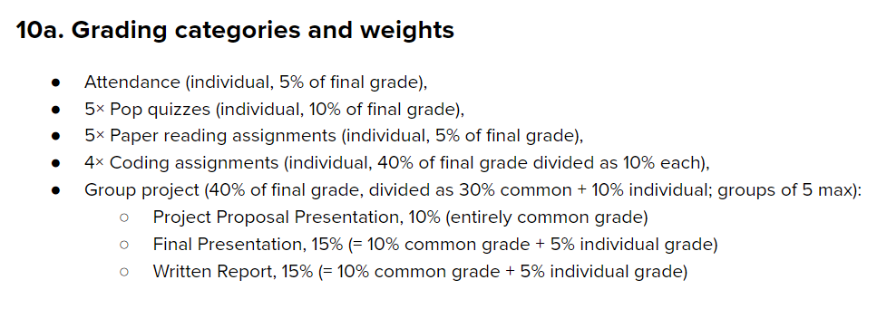

Slide 4
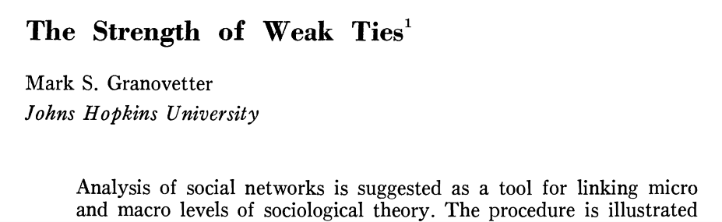

Slide 5
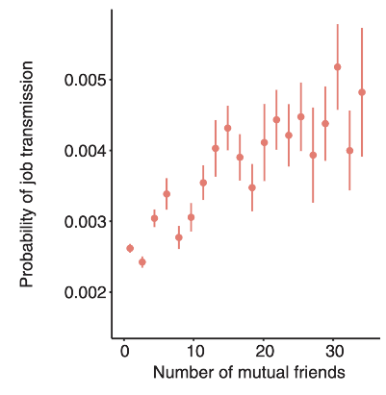



4 mutual friends
Strong ties appear to work better!

Slide 6
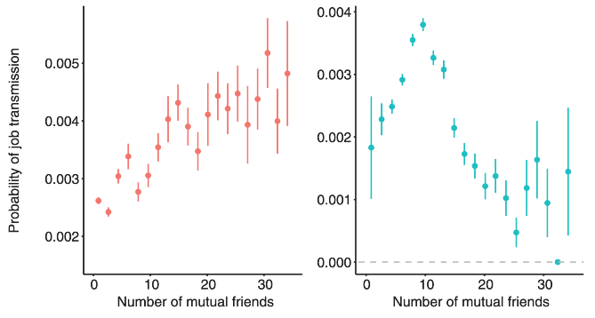
OLS
IV Regression
The strength of weak ties!
Rajkumar, Karthik, et al. "A causal test of the strength of weak ties." Science 377.6612 (2022): 1304-1310.

Slide 7
Takeaways
Two aspects of social media data:
Social: Who people interact with
Media: What they do
Large datasets can help test hypotheses never testable before!
Hypotheses are guided by social and computational theories
The appropriate tools must be chosen to get meaningful results

Slide 8












We are interested in ‘social’ + ‘media’ data
Information exchanged via contacts
Teams interact virtually
Editors interact to curate content
Collaborate on a project, ‘star’ others’ projects
Write papers together, cite others’ papers

Slide 9
Social Science
Network/computational Science
Let us not forget
Computer science
Machine learning
Ethnography
Mathematics
Optimization
And more!
Social Media Mining
Statistics and Data Mining

Slide 10
Essentials
Communities and Interactions
Applications
Graph essentials
Network measures
Network models
Community detection
Information diffusion
Social Influence
Recommendation engines
Behavior analysis
Who are the most important people in the network?
How do people befriend others?
How can we find interesting patterns in user-generated content?
How can we identify communities in a social network?
How far can an article be transmitted in a social network?
How can we measure the influence of individuals in a social network?
How can we recommend content or friends to individuals online?

Slide 11
Reminder to everyone: Python tutorials uploaded

Slide 12
Graph Essentials

Slide 13
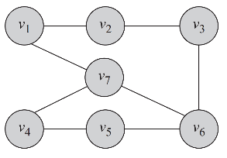
Undirected Graph

Slide 14
Undirected Graph
Facebook friends
Members of the same facebook group/subreddit
Co-located in the same zip code
Co-authored a paper

Slide 15
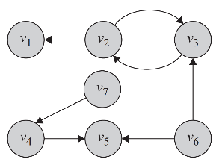
Undirected Graph
Directed Graph
Facebook friends
Members of the same facebook group/subreddit
Co-located in the same zip code
Co-authored a paper

Slide 16
Undirected Graph
Directed Graph
Facebook friends
Members of the same facebook group/subreddit
Co-located in the same zip code
Co-authored a paper
Twitter follower/followee
Cited the other person’s paper
Took creative inspiration from another person
Gave another person feedback

Slide 17
How do you represent graphs?

Slide 18
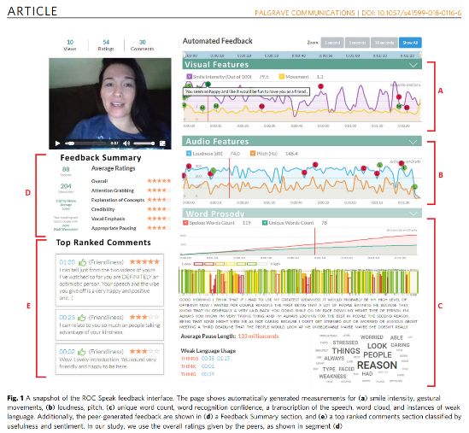

Slide 19
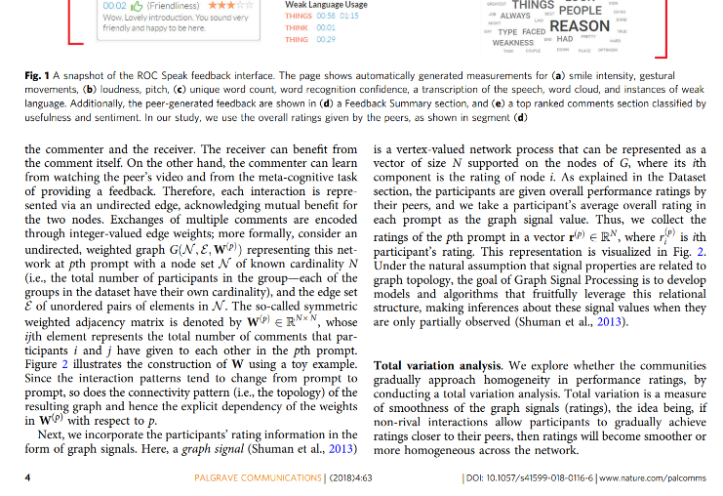

Slide 20


Slide 21
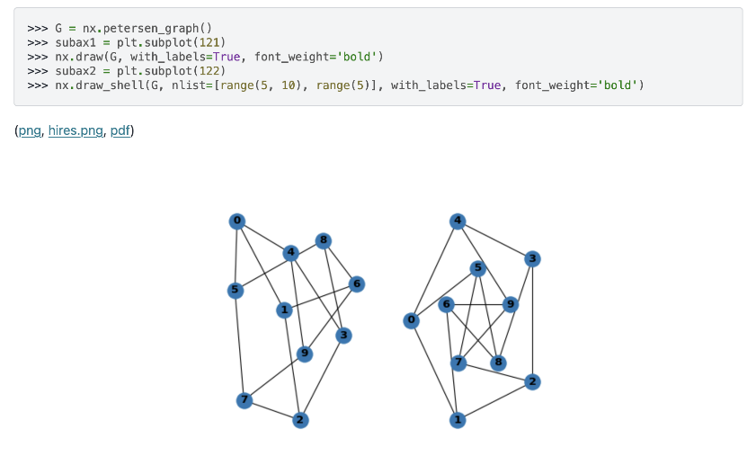

Slide 22


Slide 23
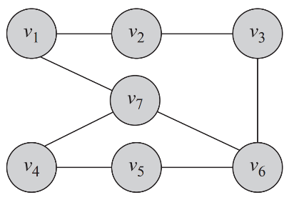


Slide 24


Slide 25
e₁
e₂
e₃
e₈
e₅
e₄
e₆
e₇

Slide 26

e₁
e₂
e₃
e₈
e₅
e₄
e₆
e₇
G(V,E) denotes our undirected graph, where V is the set of nodes and E is the set of edges

Slide 27
e₁
e₂
e₃
e₈
e₅
e₄
e₆
e₇
G(V,E) denotes our undirected graph, where V is the set of nodes and E is the set of edges
|V| and |E| denote sizes of the respective node and edge sets

Slide 28
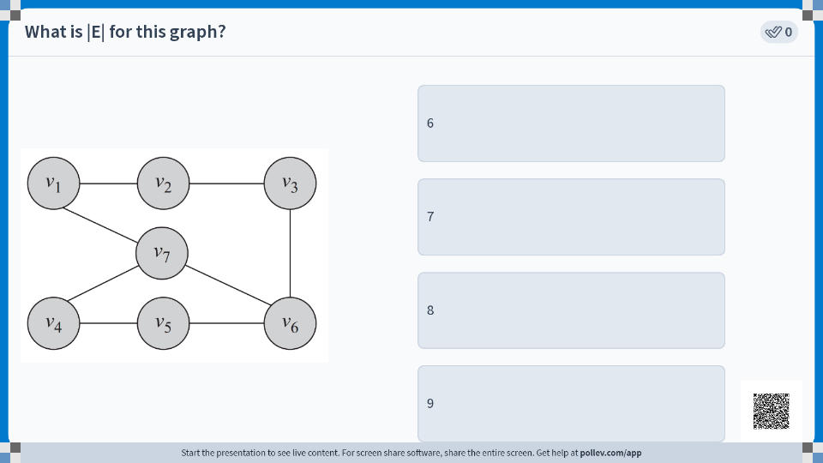


Slide 29
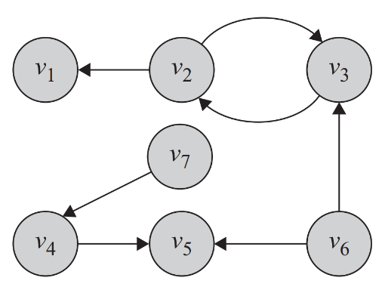
A directed graph can also be represented with the same notation of G(V,E)

Slide 30
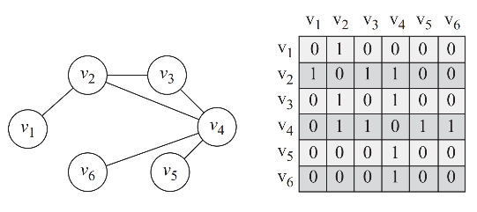

Adjacency Matrix
A 2D matrix, A, with rows and columns denoting nodes
A value of 1 in position A_{i,j} denotes that v_{i} is connected to v_{j}
All other entries are 0

Slide 31
Adjacency Matrix
A 2D matrix, A, with rows and columns denoting nodes
A value of 1 in position A_{i,j} denotes that v_{i} is connected to v_{j}
All other entries are 0

Slide 32
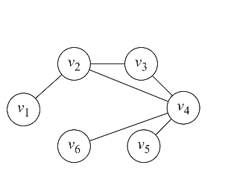
Adjacency Matrix - Weighted
If you have edge weights, plug those in as matrix entries
v₂ and v₃ interacted 4 times, everyone else interacted just once

Slide 33
Adjacency Matrix - Weighted
If you have edge weights, plug those in as matrix entries
v₂ and v₃ interacted 4 times, everyone else interacted just once
4
4

Slide 34
Adjacency Matrix - Directed
If an edge goes from v_{i} to v_{j}, only the A_{i,j} entry should capture that, not A_{j,i}

Slide 35
Properties of Adjacency Matrices
For undirected graphs, A is symmetric: A^{T} = A
Not true for directed graphs
Diagonal entries indicate self-loops
Example?

Slide 36
Adjacency Matrices have pros and cons
It is a matrix
Linear algebra wizardry comes into play!
Rich literature on Graph Spectral properties
But it is a Sparse matrix
For a billion-people network, you need a 1B x 1B matrix 🤯

Slide 37
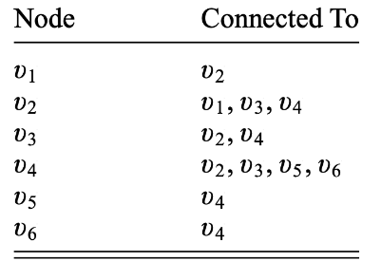
Adjacency List

Slide 38
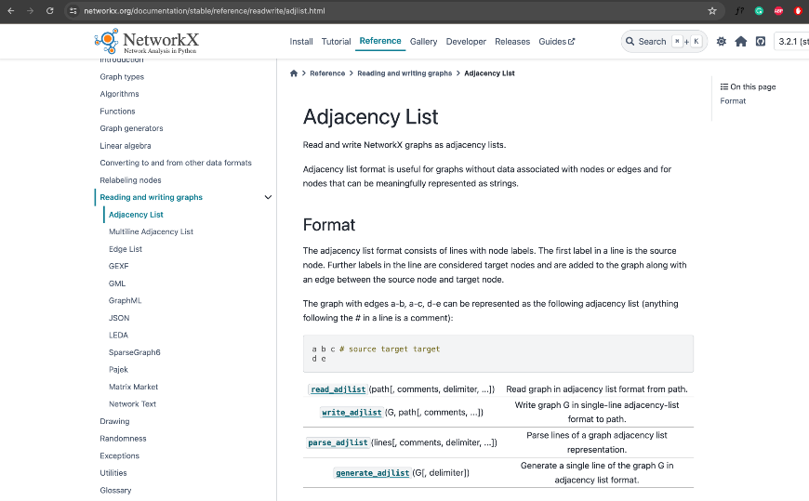

Slide 39
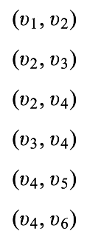
Edge List

Slide 40


Slide 41
Null and Empty graphs
Null graph
No nodes
Obviously no edges either
Empty graph
There are nodes but no edges
Example?

Slide 42
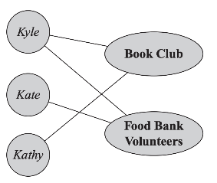
Bipartite Graphs

Slide 43
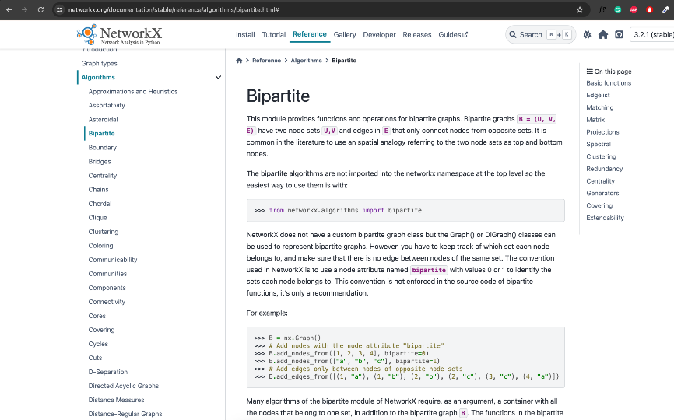

Slide 44
Reading
Chapter 2.1 - 2.5 (inclusive) of the textbook

